Slide 1
Leaving Cert Applied Pre-Cookery Exam 2013
Congratulations to all 10 students who got good results

Slide 2
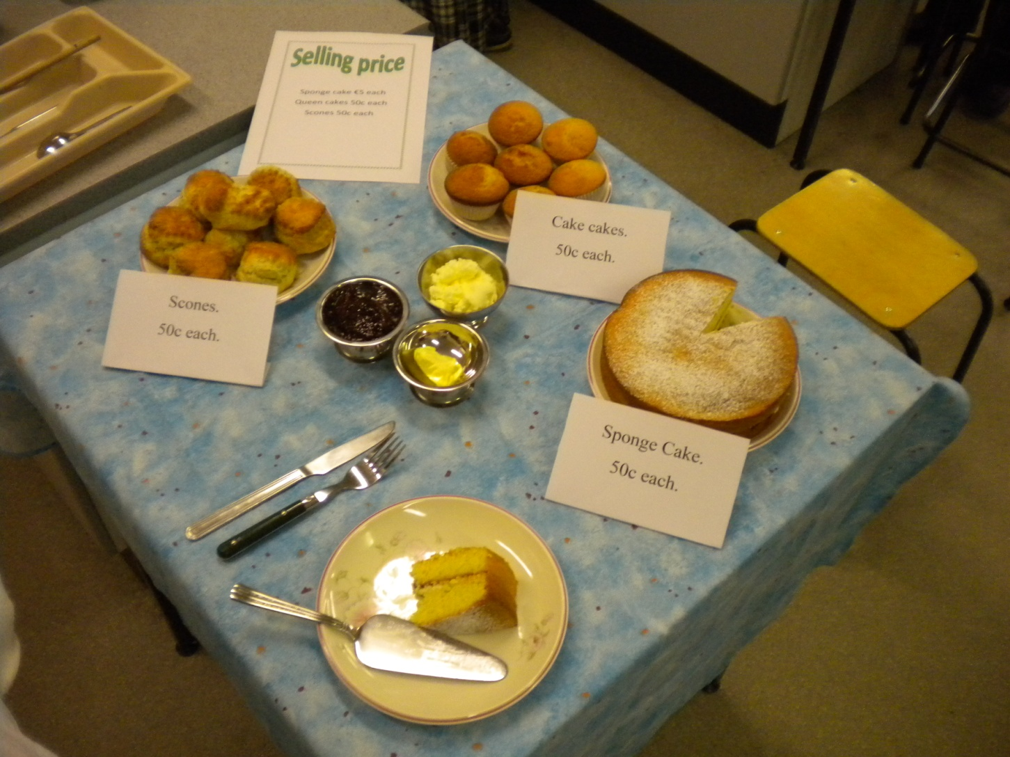
Natasha created a Cake Sale with three different mixture methods – Scones (rubbing-in), Queen Cakes (creaming) and Sponge Cake (whisking). She had to cost the ingredients as well.

Slide 3
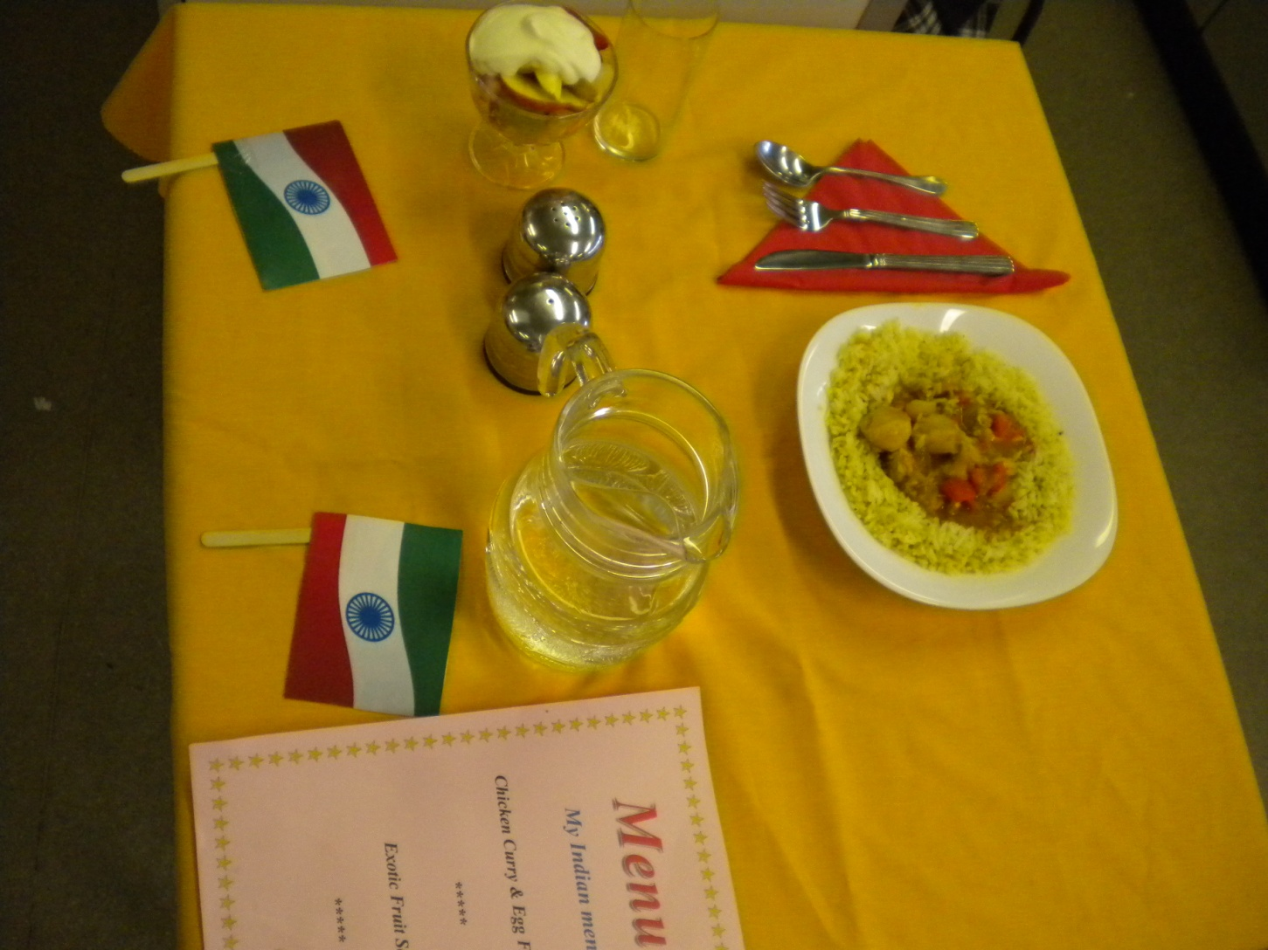
Lisa’s assignment was Ethnic Cuisine and she choose India.
The Indian meal served a delicious chicken curry with egg-fried rice and fresh fruit salad for dessert

Slide 4
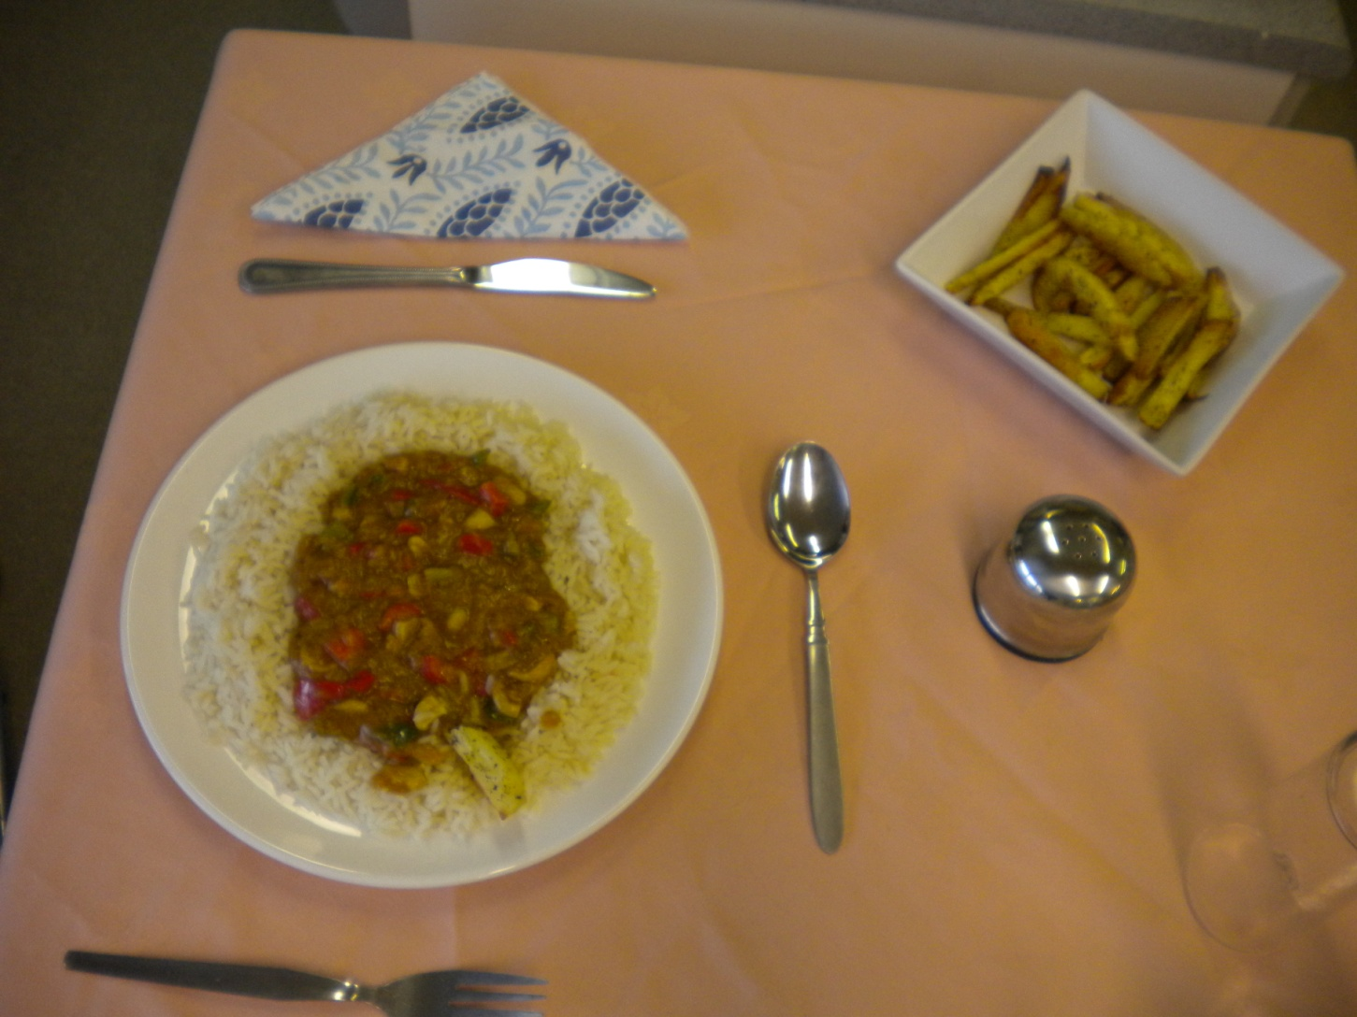
Cathal choose the vegan (strict vegetarian) option and he used ‘plate service’ to serve a cashew nut curry with boiled rice and spicy wedges

Slide 5
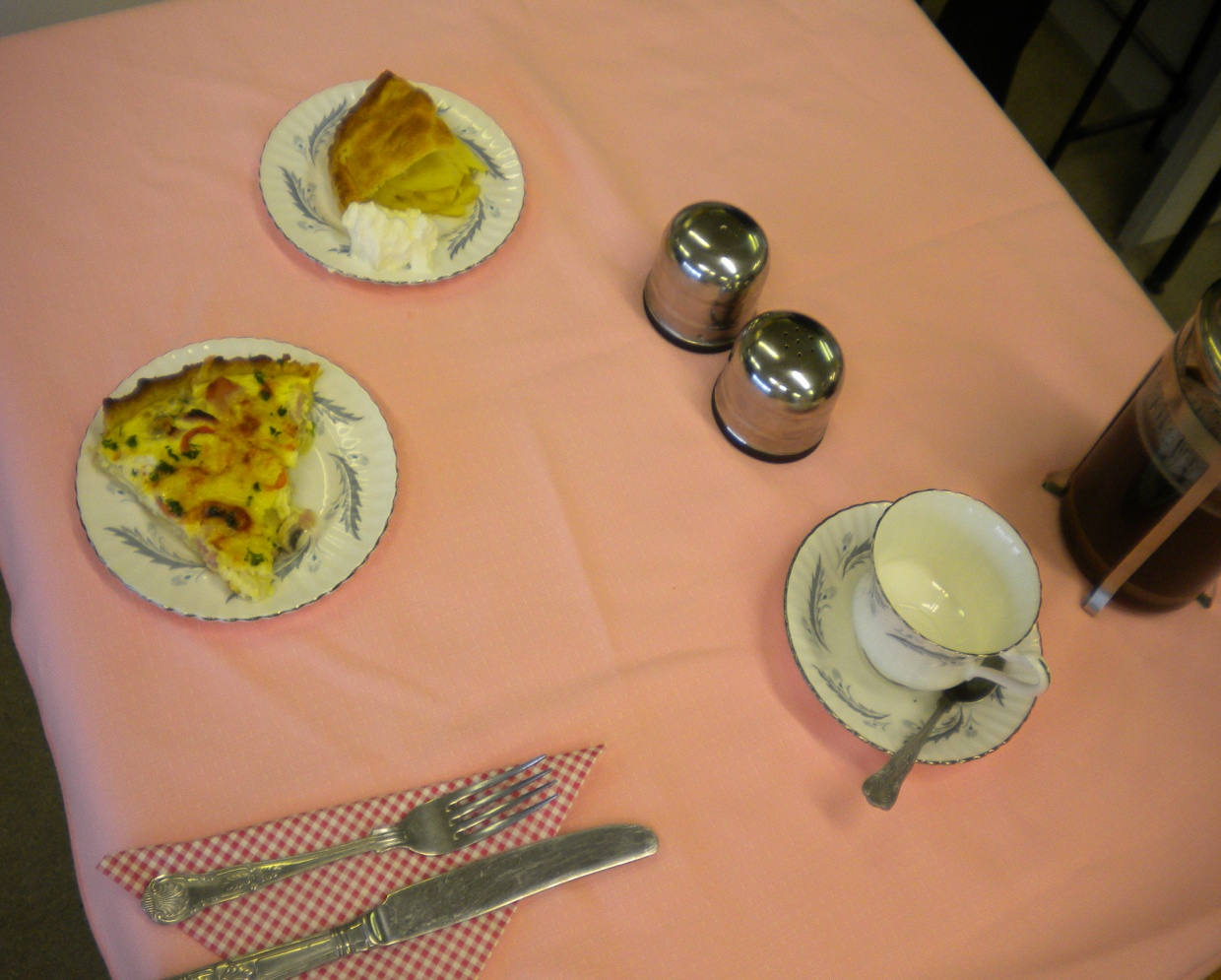
Jack’s assignment was for a coffee shop and he had to make two types of pastry and serve one sweet and one savoury dish.
He made wholemeal cheese and bacon quiche and apple tart with cream.
Jack also served fresh hot coffee.

Slide 6
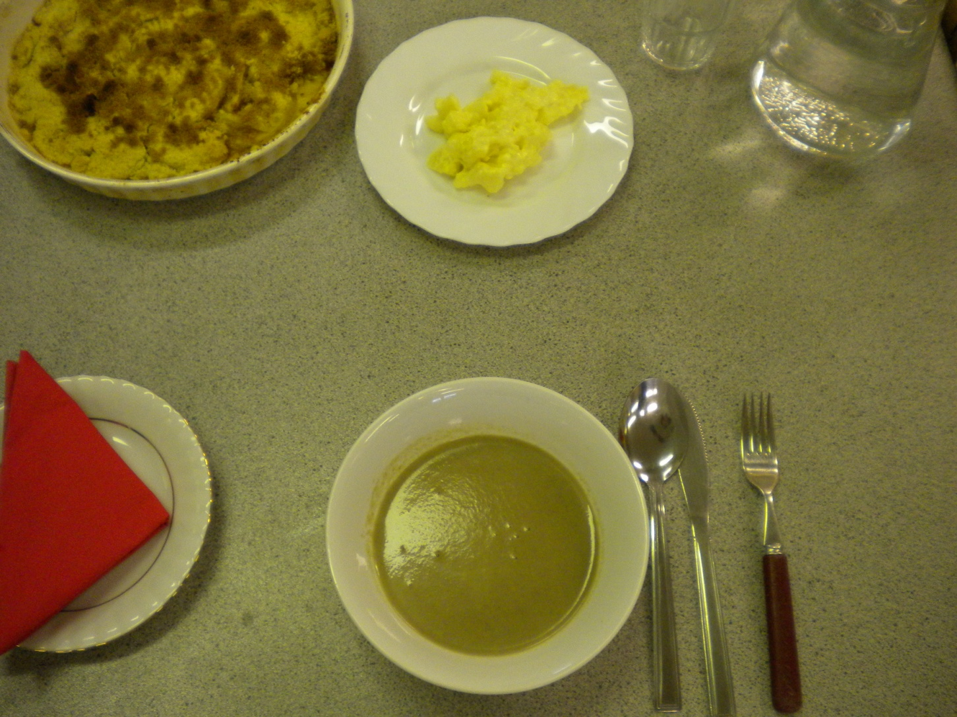
John was promoting fresh fruit and vegetables .
He served a delicious fresh mushroom soup, followed by apple crumble.

Slide 7
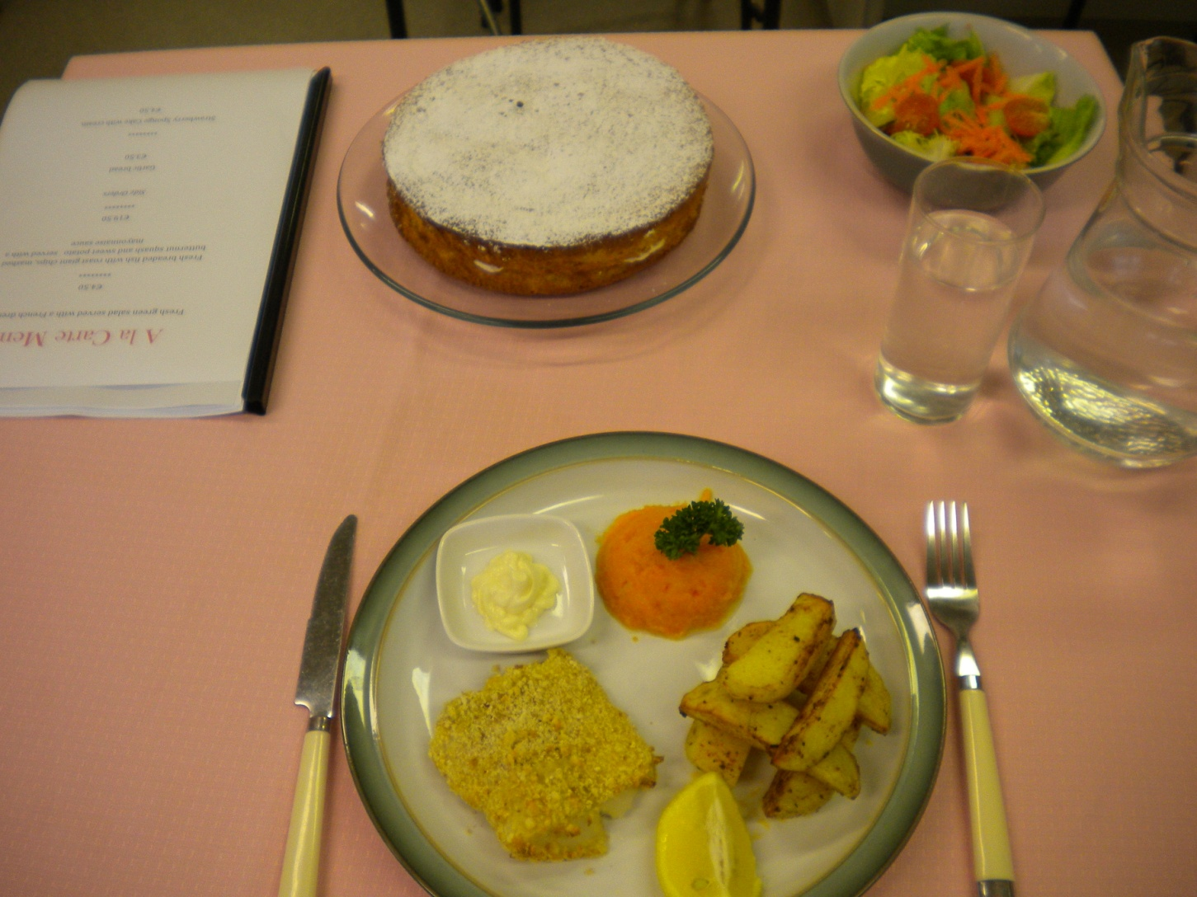
Diarmuid designed an
A la Carte menu of
Baked, breaded Cod with Spicy baked steak chips,
Puree of butternut and sweet potato with a mayonnaise sauce
***
Side salad
***
Sponge cake filled with fruit and cream

Slide 8
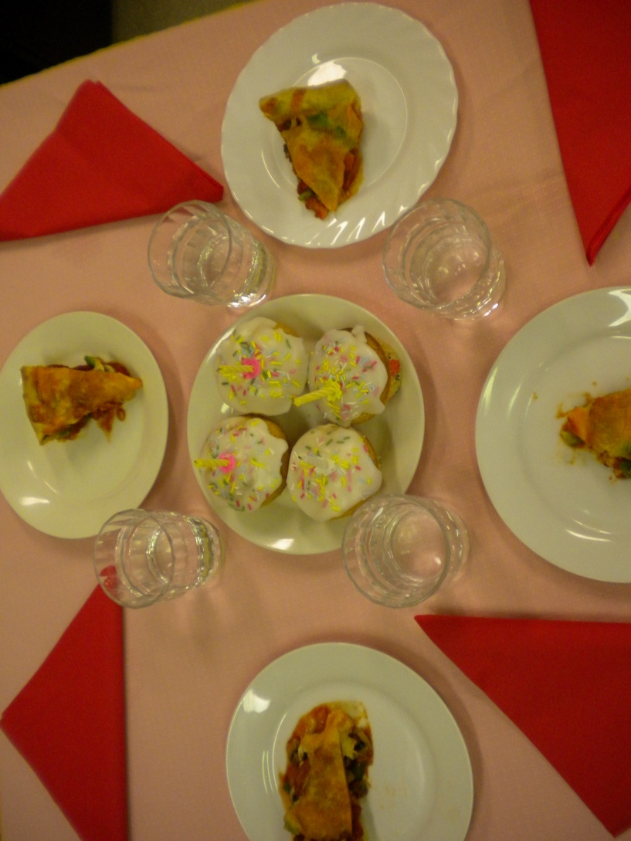
Niall designed as menu for a child’s birthday party.
He made popular pizza and served iced buns for dessert.

Slide 9
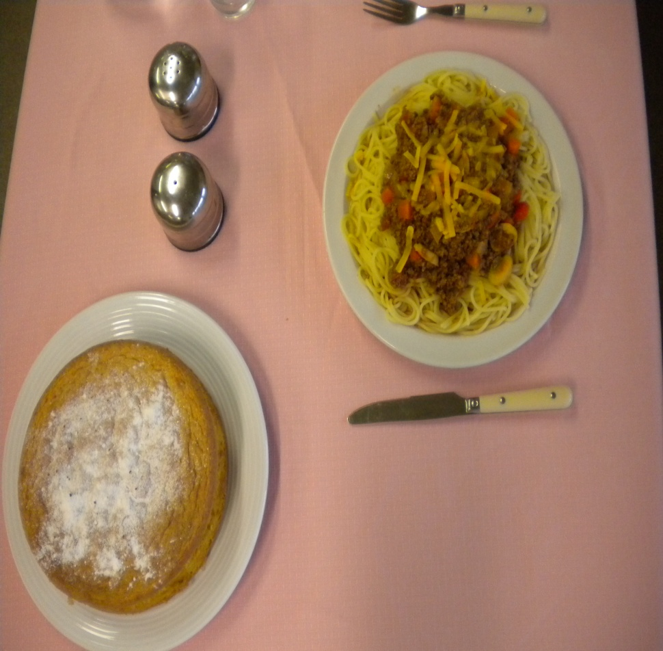
Katie had to make an economical 2-course meal.
She had to price all the ingredients to get the cheapest meal possible.
Spaghetti Bolognese was followed by jam sponge cake.

Slide 10
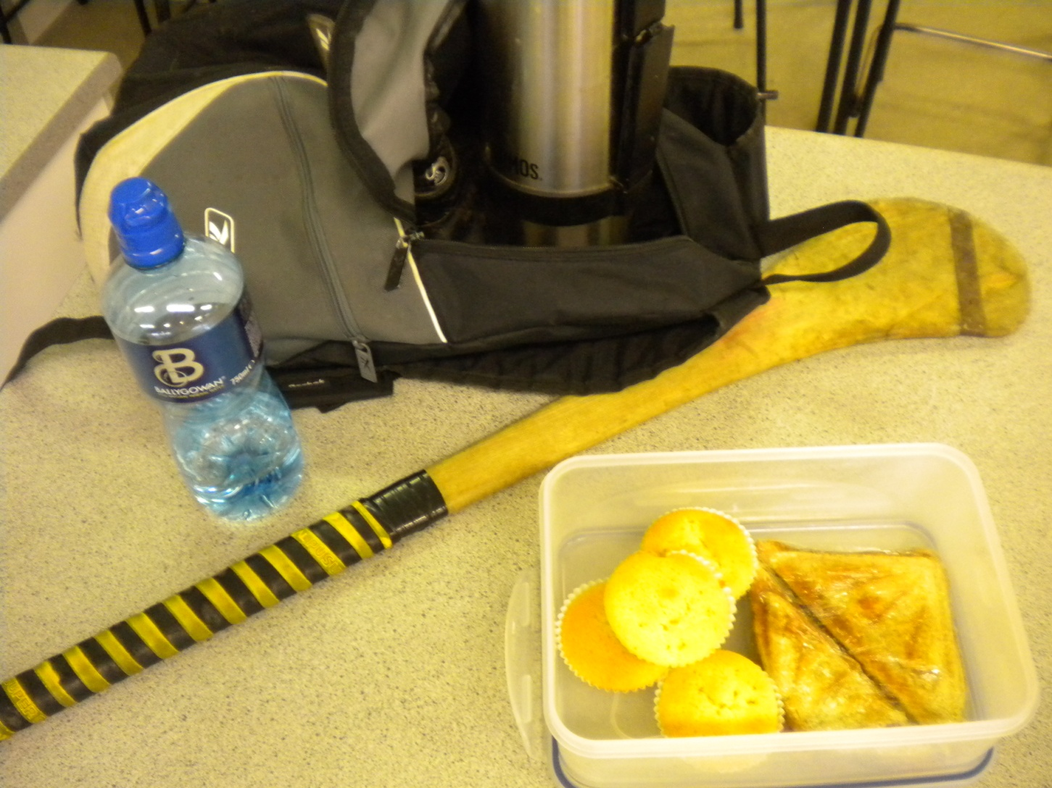
Daniel had to make a healthy packed lunch for after a sport’s event.
He chose fresh vegetable soup with a toasted ham and cheese sandwich followed by queen cakes

Slide 11
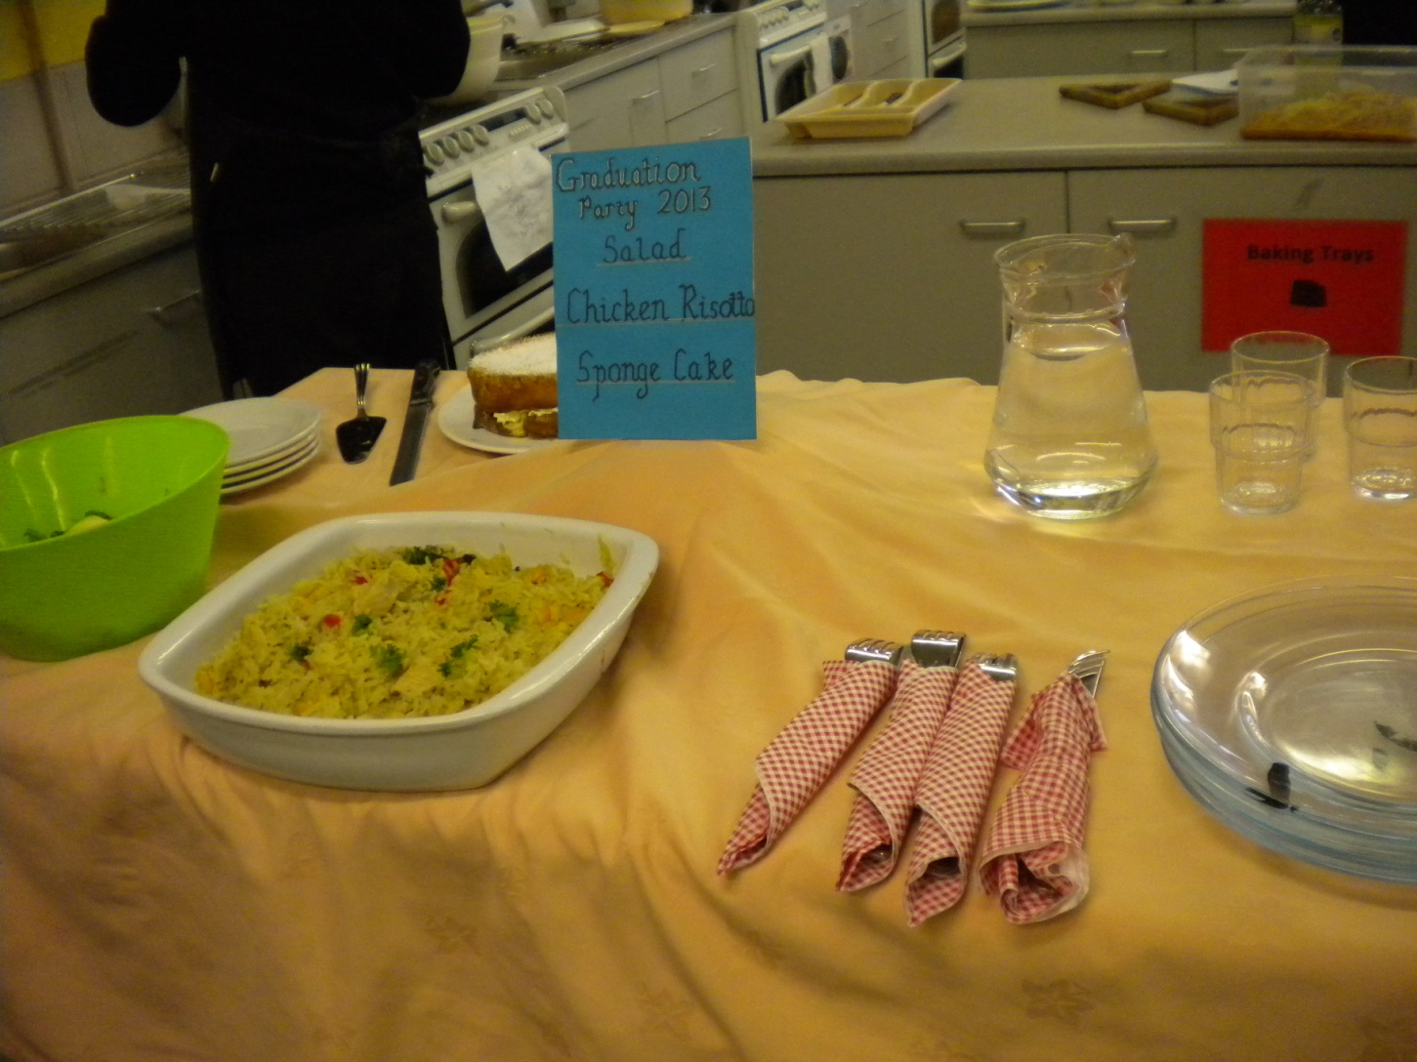
Michael set up a buffet for a Graduation Party.
He served chicken risotto with tossed salad followed by delicious jam and cream sponge cake

